Slide 1
Intermediate Computer Programming
Prichard & Carrano,
Chp. 1.1 – 1.5 & 2 (pp. 3 – 40, 81 – 135)
Topic 1 – Review of Java Fundamentals and Principles of Programming

Slide 2
Topics Covered in CSC 171
Basic program structure
Data types
Input / Output
IF statements
LOOPS (for / while / do-while)
Methods and parameters
Strings and Arrays
Objects and Classes

Slide 3
Java Language Basics
Program is a collection of classes
One class (the driver class) contains the main method
Instructions organized into one or more methods (a named set of instructions that can be invoked)
Can declare variables to hold a value of a primitive type or a reference to an object
Allows you to save a value by giving it a name, so you can refer to it later

Slide 4
Basic Framework
public class ClassName {
// Introductory comment
public static void main(String [] args){
instructions (variable declarations / expressions / etc)
}
}

Slide 5
Class Header
Keyword: denotes this is a class
public class ClassName {
}
Name of our class:
Class names must be a single word
Convention is that class names start with capital letter
If using multiple words, remove spaces and capitalize first letter of each word
Keyword: denotes this is "public" (rather than "private")
Notes:
3

Slide 6
Method Header
Argument list – main method will always use this argument list
public class MyFirstProgram {
public static void main(String[] args){
}
}
Method name:
"main" is a special name for the main method
Convention is that method names start with lower case letter
Return type
Denotes method is public (as opposed to private)
Optional keyword to denote method is static
Notes:
3

Slide 7
Method Statements
public class MyFirstProgram {
public static void main(String[] args){
System.out.println("Hello, world!");
}
}
This is our basic print statement that allows output to be printed to the terminal.
Statements appear after method header, separated by semi-colons:
Each statement is executed in order that they appear.
Statements are case-sensitive.
Notes:
3

Slide 8
Variables
Essentially a named value
Contains a value of a primitive type or a reference to an object
Variables must be declared (only once) before they can be used
Declare by stating its type followed by its name or identifier:
double radius; // the radius of a circle
int sum; // an integer representing a sum
String name; // reference to a String object (a name)
Scanner scan; // Scanner object to read input
Thing one; // Some generic Thing object

Slide 9
Data Types
Java has 8 pre-defined primitive data types with reserved words to identify them: byte short int long float double char boolean
Everything else are objects (think of as customized data types)
Some are pre-defined and we use extensively:
String Scanner Random
But more useful is we can create our own classes to make our own data types Person Grade Sphere

Slide 10
Assignments and Expressions
Expressions: A combination of variables, constants, operators, and parentheses
Java will evaluate the expression and come up with a result for the evaluation
Assignment statement: Assigns a value to a variable double radius = r; int sum = a + b;
Expressions can include arithmetic expressions as well as method calls (the result of invoking a method)

Slide 11
Strings
A collection of characters that are read and written together
NOT a primitive data type, but part of a standard class of objects provided by Java
Although an object, Java supports some shorthand instructions to use Strings like primitive data types
Java provides a library of non-static methods that can be called on existing String objects

Slide 12
Non-Static vs. Static Methods
A non-static method is a method that is intended to be an operation performed on an object
Must be invoked on an existing instance of the class to which the non-static method belongs
Think of it as telling a specific instance of an object to perform an action
The result may change depending on the instance's properties
A static method is called without reference to a specific object
Static = not changing – the result of a static method does not depend on the circumstances of the program
Any data required for the operation will be passed in as parameters

Slide 13
Boolean Expressions
A boolean value or expression is one that can either be true or false
Necessary for branch and loop statements
Relational expressions – compare two values
Logical expressions - && / ||

Slide 14
Java String Methods
s.length() – Returns the number of characters in s
s.trim() – Returns s with leading and trailing whitespace characters removed
s.concat() – Returns s with another string concatenated to it
s.substring() – Returns a substring of s
s.indexOf() – Returns the starting position of the first occurrence of a substring within s

Slide 15
Java String Methods
s.equals(t) – Returns true if s and t are the same string
s.equalsIgnoreCase(t) – Returns true if s and t differ in case only
s.compareTo(t) –
Is 0 (zero) if s and t are the same
Is positive if s comes after t
Is negative if s comes before t

Slide 16
Branches
IF: Executes a block of statements only if a test is true
if (test) { statement; ... statement; }
IF / ELSE: Executes a block of statements only if a test is true, another block of statements if the test is false
if (test) { statement(s); } else { statement(s); }

Slide 17
Decision Flow
if statement
if/else statement
Is test true?
Is test true?
yes
no
yes
Execute the controlled statement(s)
Execute the "else" controlled statement(s)
Execute the "if" controlled statement(s)
no
Execute next statement after if statement
Execute next statement after if statement
Notes:
3

Slide 18
Example – Age.java
Program will prompt and read in the name and age of two people, and print a message stating who is older
Basic algorithm:
Prompt and read in the name and age of person 1.
Prompt and read in the name and age of person 2.
Compare the two ages and print statement saying who is older.

Slide 19
Loops
We learned three different types of loops in CSC 171
Conditional loops (while / do-while): repeats a block of instructions as long as a condition is true
while loop checks the condition and then executes the block if the condition is true (thus is possible the block never executes)
do-while loop executes the block and then checks the condition to see if it should do it again (guaranteed to run at least once)
Counting loops (for): set up to repeat a block of instructions a pre-set number of times

Slide 20
WHILE / DO-WHILE
Syntax: while (condition) { statement(s) } do { statement(s)
} while (condition);

Slide 21
FOR
Syntax:
for (expr1; expr2; expr3) {
statement(s); }
The for loop header requires 3 expressions:
Expr1 – initialize the counter variable (usually to 0 or 1)
Expr2 – sets the condition (keep repeating as long as condition is true)
Expr3 – updates the counter variable (usually increment)

Slide 22
Example – RepeatHelloWorld.java
Program will prompt the user to enter the number of times to repeat the greeting. Then it will print out "Hello, world!" that number of times (once per line)
Basic algorithm:
1. Prompt and read in number of times (n) to print greeting
2. Set up FOR loop to run n times
2.1 Each time through loop, println "Hello, world!"

Slide 23
Arrays
Collection of elements with the same data type
Array elements have an order and have an index number
Can directly access a specific element via the index number
To declare and initialize:
BaseType [] arrayName = new BaseType[Length];
int[] x = new int[10]; //an array of 10 ints called x String[] names = new String[8]; //an array of 8 Strings // called names

Slide 24
Arrays
For loops are really useful when you want to manipulate arrays
Rather than individually access each element in separate instructions, set up a for loop, where the counter variable is used as the index:
for (int i = 0; i < x.length; i++) System.out.println(x[i]);

Slide 25
Packages and Import Statements
A package is Java's way of forming a library of classes
Use an import statement to use a package that is not in the directory in which you are working
import java.util.;
The java.lang package is automatically imported to all Java programs

Slide 26
Problem Solving
Programming is all about problem solving
Start by creating an algorithm – a step-by-step sequence of steps to solve a problem
Once the algorithm is verified to solve the problem, translate the algorithm steps to Java code instructions

Slide 27
Problem Solving
The general steps in problem solving:
Understand the problem
Dissect the problem into manageable pieces
Design a solution
Consider alternatives to the solution and refine
Implement the solution
This is where you usually write the code. Note where in the process this step occurs!
Test the solution and fix any problems that exist
Notes:
3

Slide 28
The Life Cycle of Software
Phase 1: Specification
Aspects of the problem which must be specified:
What is the input data?
What data is valid and what data is invalid?
Who will use the software, and what user interface should be used?
What error detection and error messages are desirable?
What assumptions are possible?
Are there special cases?
What is the form of the output?
What documentation is necessary?
What enhancements to the program are likely in the future?

Slide 29
The Life Cycle of Software
Phase 1: Specification (Continued)
Prototype program
A program that simulates the behavior of portions of the desired software product
Phase 2: Design
Includes:
Dividing the program into modules
Specifying the purpose of each module
Specifying the data flow among modules

Slide 30
The Life Cycle of Software
Phase 2: Design (Continued)
Modules
Self-contained units of code
Should be designed to be:
Loosely coupled
Highly cohesive
Interfaces
Communication mechanisms among modules

Slide 31
The Life Cycle of Software
Phase 2: Design (Continued)
Specifications of a method
A contract between the method and the module that calls it
Should not commit the method to a particular way of performing its task
Include the method’s:
Precondition
A statement of the conditions that must exist at the beginning of the method
Postcondition
A statement of the conditions at the end of the method

Slide 32
The Life Cycle of Software
Phase 3: Risk Analysis
Building software entails risks
Techniques exist to identify, assess, and manage the risks of creating a software product
Phase 4: Verification
Formal methods can be used to prove that an algorithm is correct
Assertion
A statement about a particular condition at a certain point in an algorithm
Java’s assert statement: assert booleanExpression;

Slide 33
The Life Cycle of Software
Phase 4: Verification (Continued)
Invariant
A condition that is always true at a particular point in an algorithm
Loop invariant
A condition that is true before and after each execution of an algorithm’s loop
Can be used to detect errors before coding is started

Slide 34
The Life Cycle of Software
Phase 4: Verification (Continued)
The invariant for a correct loop is true:
Initially, after any initialization steps, but before the loop begins execution
Before every iteration of the loop
After every iteration of the loop
After the loop terminates
Phase 5: Coding
Involves:
Translating the design into a particular programming language
Removing syntax errors

Slide 35
The Life Cycle of Software
Phase 6: Testing
Involves:
Removing the logical errors
Test data should include:
Valid data that leads to a known result
Invalid data
Random data
Actual data

Slide 36
The Life Cycle of Software
Phase 7: Refining the Solution
During phases 1 through 6
A working program is developed under simplifying assumptions
During phase 7
Refining sophistication is added, such as:
More sophisticated input and output routines
Additional features
More error checks

Slide 37
The Life Cycle of Software
Phase 8: Production
Involves:
Distribution to the intended users
Use by the users
Phase 9: Maintenance
Involves
Correcting user-detected errors
Adding more features
Modifying existing portions to suit the users better

Slide 38
Abstraction and Information Hiding
Ideally, a solution should be modularized – confine implementation details into smaller modules and keep details contained within the modules
"I know this method will perform this task and I know how to use the method to perform the task… but I don't care how it performs the task."
Information hiding: hide details within a module
Ensure that no other module can tamper with these hidden details

Slide 39
Object-Oriented Design
Object-oriented approach to modularity
Produces a collection of objects that have behaviors
Object
An instance of a class
Combines data and operations on that data
Encapsulation
A technique that hides inner details
Methods encapsulate actions
Objects encapsulate data as well as actions

Slide 40
Object-Oriented Design
Principles of object-oriented programming (OOP)
Encapsulation
Objects combine data and operations
Inheritance
Classes can inherit properties from other classes
Polymorphism
Objects can determine appropriate operations at execution time

Slide 41
Functional Decomposition
Object-oriented design (OOD)
Produces modular solutions for problems that primarily involve data
Identifies objects by focusing on the nouns in the problem statement
Functional Decomposition (FD)
Produces modular solutions for problems in which the emphasis is on the algorithms
Identifies actions by focusing on the verbs in the problem statement
A task is addressed at successively lower levels of detail

Slide 42
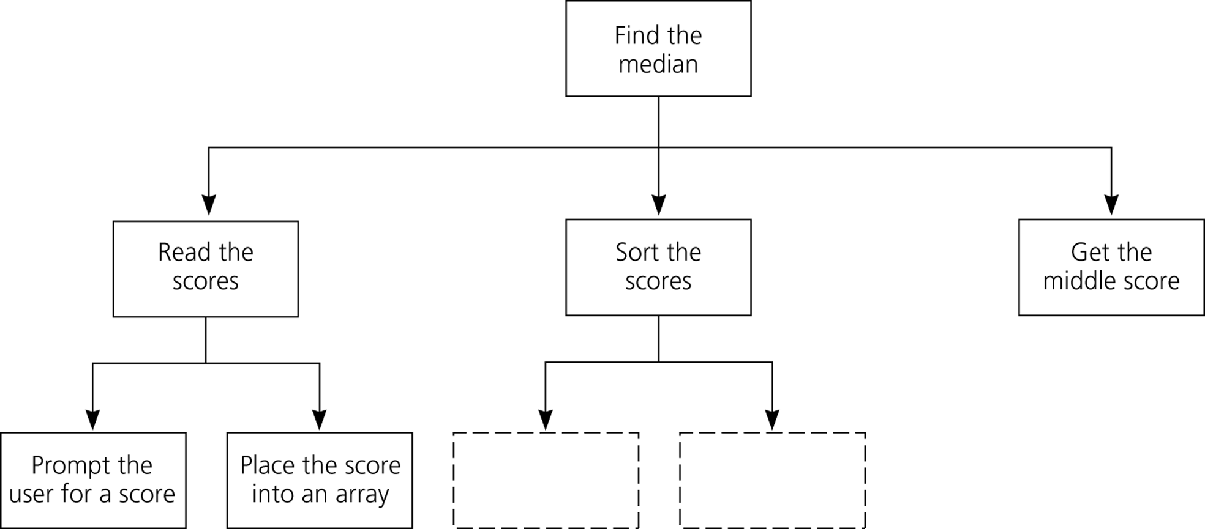
Functional Decomposition
Figure 2-4
A structure chart showing the hierarchy of modules

